Slide 1
Effects of Housing Volume Increase in Orange County
UCF Data Analysis Bootcamp – Group Project 1
March 9, 2019

Slide 2
Proposal and Resources
As a group we are interested in housing in Central Florida and how, as the volume of housing increases, the rate of private ownership versus rental becomes inverse. Is home ownership becoming a less attainable goal?
As the overall volume of housing increases over time:
Availability – Fewer homes available for purchase. We expect that the large volume of housing is going to rental homes. Our research question: how has the proportion of available homes to rental homes changed over the last five years?
Affordability –Affordability decreases. We expect that the proportion of average household income to average housing cost to grow over time. Our research question: how has the proportion of average household income to average housing cost changed over time?
Demographics – The population grow sand demographics will skew. We expect to find a population that implies gentrification: has more education and a change in race/ethnicity and age. Depending on the changes, this could imply new industry, a migration pattern or many other phenomena. While this would not be definitive, it would start us on new paths to make further queries. How have the demographics of the local population Florida changed over the last five years and if any of these changes have a noticeable impact on housing availability and costs?
Proposal
Criteria
Orange County, Florida for years 2014-2017
Resources
Multiple Listing Service (MLS) .csv
The US census: American Community Survey API

Slide 3
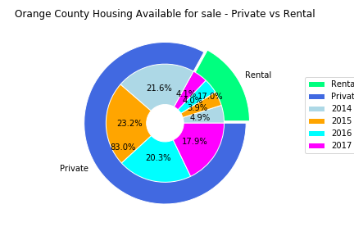
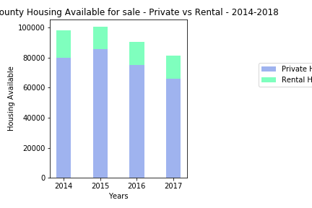
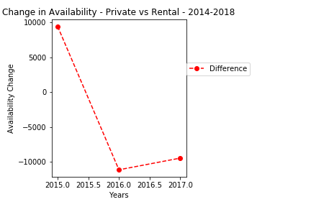
Availability – Private vs Rental Housing
Conclusion
Availability – Fewer homes available for purchase. We expect that the large volume of housing is going to rental homes. Our research question: how has the proportion of available homes to rental homes changed over the last five years?
Rental | Private | Difference | Change
18141 | 80137 | 61996
14561 | 85971 | 71410 | 9414
15008 | 75308 | 60300 | -11110
15375 | 66236 | 50861 | -9439
As expected, housing availability for Private ownership far exceeds the number of housing available for Rental purposes (fig1). A look within the breakdown of the data shows the peak of Private Housing available in 2015 and decreasing by about 10,000 each year. The peak rental was in 2014, with a sharp decline in 2015 and is increasing slowly, but steadily.
Figure 1
In our four year measure, 2015 was the peak in housing available for sale listed on MLS market (fig2). Subsequent years have seen a slight decline in the total available, however, the rentals available for sale have been increasing. This could mean that either existing rentals for sale have been increasing and/or there are new properties being offered for sale for Rental purposes. A look at the Private housing available for sale show a peak in 2015 with a steady decline thereafter (fig3). This indicates a relationship between the decline in available Housing in the Private housing market and the housing available for sale for rental.
Figure 2
Figure 3
Housing Available for sale: Housing listed for sale on MLS.
Private Housing Available: placed for sale by homeowners
Rental Housing Available: placed for sale for rental purposes
Resource
Multiple Listing Service (MLS) .csv

Slide 4
Affordability – Sales Numbers vs Sales Price
Affordability –Affordability decreases. We expect that the proportion of average household income to average housing cost to grow over time. Our research question: how has the proportion of average household income to average housing cost changed over time?
Figure 4 blurb
Figure 4
Resource
Multiple Listing Service (MLS) .csv

Slide 5
Demographics –
Demographics – The population grow sand demographics will skew. We expect to find a population that implies gentrification: has more education and a change in race/ethnicity and age. Depending on the changes, this could imply new industry, a migration pattern or many other phenomena. While this would not be definitive, it would start us on new paths to make further queries. How have the demographics of the local population Florida changed over the last five years and if any of these changes have a noticeable impact on housing availability and costs?
Figure 5 blurb
Figure 5
Conclusion
Resource
The US census: American Community Survey API

Slide 6
Findings/Summary(?) and Conclusion
Findings/Summary(?)
Summary of the findings. Were hypothesis/null-hypothesis proved?
Conclusion
Hypthesis/null hypothesis proved?

Slide 7
Resources
Data Source
Multiple Listing Service (MLS) .csv (website address/details?)
The US census: American Community Survey API (website address/details?)
Figures
Fig. 1 – AvailNestedPC.png
Fig. 2 – RentalVsPrivateSBC.png
Fig. 3 - RentalVsPrivateDelta.png

